Slide 1
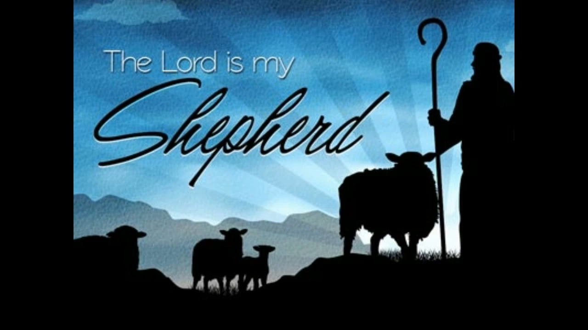
The 23rd Psalm Psalms of Guidance April 17, 2022

Slide 2
Psalms 23
1 The LORD is my shepherd; FAITH I shall not want. ASSURANCE
2 He maketh me to lie down in green pastures: CONTENTMENT he leadeth me beside the still waters. PEACE

Slide 3
Life – “He restoreth my soul”
To restore the soul seems to imply life again, healing. cf. James 2:26
Forgiveness and fellowship. Luke 15:17-20; cf. Psalms 51
By repentance and conversion. Luke 22:32 (Acts 3:19; 26:18)
“Restore again.” His sheep are not only being led; they are being led back home. (Ezekiel 34:16)

Slide 4
Life – “He restoreth my soul”
To restore the soul seems to imply life again. cf. James 2:26
“If a man die, shall he live again.” Job 14:14
This is why David was not afraid to walk through the valley of the shadow of death.
This is why he ate instead of fasting when his son died.
He could go to him. 2 Samuel 12:22-23
Evidently David foresaw the resurrection. cf. Psalms 16:10; Acts 2:31
Jesus spoke of the resurrection. John 11:25
All will be raised. John 5:28-29

Slide 5
Leadership – “He leadeth me in the paths of righteousness for His name’s sake”
The Lord leads, David followed.
Man cannot direct his own steps. cf. Jeremiah 10:23
The “paths of righteousness” … where Wisdom walks. Proverbs 8:20
David was led by God through the teaching of the OT
Today God leads us through the NT
God’s righteousness is found in the Gospel. Romans 1:16-17
All of us are to walk by this same rule. Philippians 3:15-16
Word of truth. Psalms 119:105; John 6:68; 14:6

Slide 6
Leadership – “He leadeth me in the paths of righteousness for His name’s sake”
The Lord leads and we are to follow. Luke 9:23
Many rather elect to follow blind guides. cf. Matthew 15:14
Their end is the ditch. cf. verse 13
The Lord is the Good Shepherd and cares for the sheep. John 10:1-4, 11-14
We can follow with confidence.
“For his name’s sake.” In order that His name might be glorified. Psalms 79:9; cf. 1 Peter 2:9; Matthew 5:13-16

Slide 7
Leadership – “He leadeth me in the paths of righteousness for His name’s sake”
The Lord has the words of life.
Peter and the disciples could not look elsewhere. cf. John 6:66-68; cf. John 16:13f; Romans 8:14
Now He has proven that He can and will lead us through the valley of the shadow of death.
He was tempted. cf. Matthew 4:1-11; Hebrews 4:15
He died. Hebrews 2:14-15; cf. Revelation 1:17-18
And He proved that man can and will be raised from the dead. cf. Acts 2:24; Colossians 2:15
We are to walk as He walked. 1 John 2:5-6; 1 Peter 2:21

Slide 8
Psalms 23
1 The LORD is my shepherd; FAITH I shall not want. ASSURANCE
2 He maketh me to lie down in green pastures: CONTENTMENT he leadeth me beside the still waters. PEACE
3 He restoreth my soul: LIFE he leadeth me in the paths of righteousness for his name’s sake. LEADERSHIP
4 Yea, though I walk through the valley of the shadow of death, CONFIDENCE

Slide 9
Confidence – “Yea, though I walk through the valley of the shadow of death”
The walk is the walk all men must take. Hebrews 9:27; Ecclesiastes 9:5
Such confidence is born of hope. Philippians 1:23; 2 Corinthians 5:6, 8
Such hope should rest on the promises of God. 2 Peter 1:4; Hebrews 10:22-23
All the fear of death should be removed from us. Hebrews 2:14-15; Hebrews 13:5-6
In Christ, the terror of death gives way to joyful hope. 1 Corinthians 15:54-57

